Slide 1
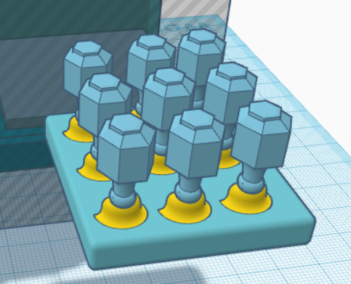
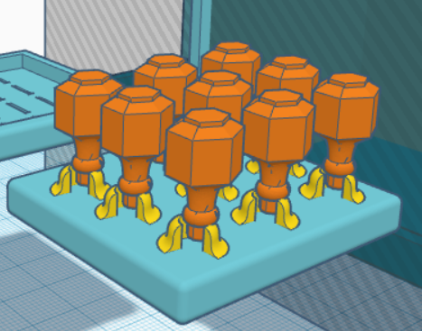
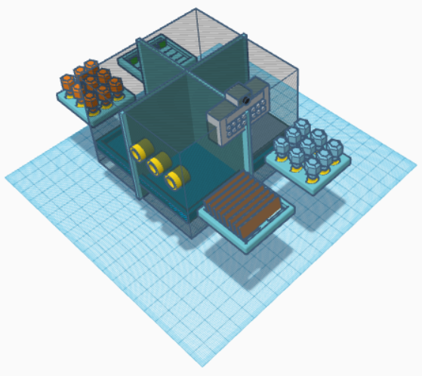
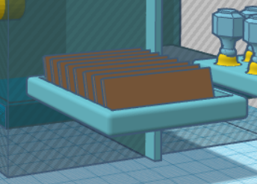
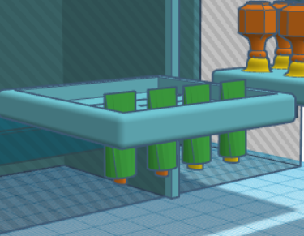
PharmaSee: An Overview and its Inspiration
Impact of Wastage on Water Bodies due to Improper Disposal of Medication
Our Proposal: A One Stop Solution for Proper Storage, Tracking, and Disposal ( Self and Take Back Programs) of Pharmaceutical Drugs and Components
Statistics
Structural
Tight sealed holder
Automatic dispensing and disposal
USA
Europe
PharmaSee
Liquid
Drop Based
Studies found that 80% of samples from the USA and 100% from EU are polluted with pharmaceutical residues
Commonly found drugs include antibiotics, analgesics, anti-inflammatories, hormones, and antidepressants
Ventilation slots for tablets and capsules
Sandmixing disposal container
Impact on Aquatic animals
Chemicals found in antidepressants can affect the behaviour and reproductive effect
The presence of antibiotic residues can promote the development of antibiotic-resistant bacteria
NSAID can cause renal failure and death in fish at concentrations as low as 1 µg/L
Ventilated slots
Automated slot opening for disposal
Flexible slots
Tightly sealed cap holders
Squeeze
Tablets & Capsules
Topical Medicines

Slide 2
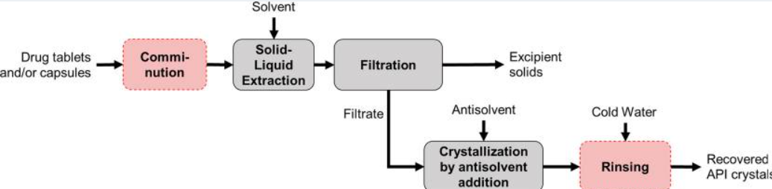
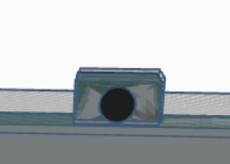
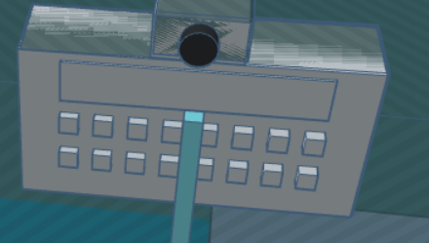
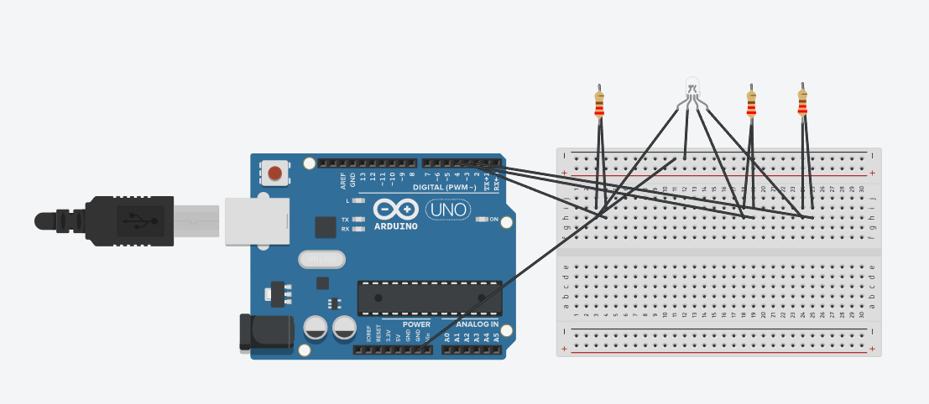
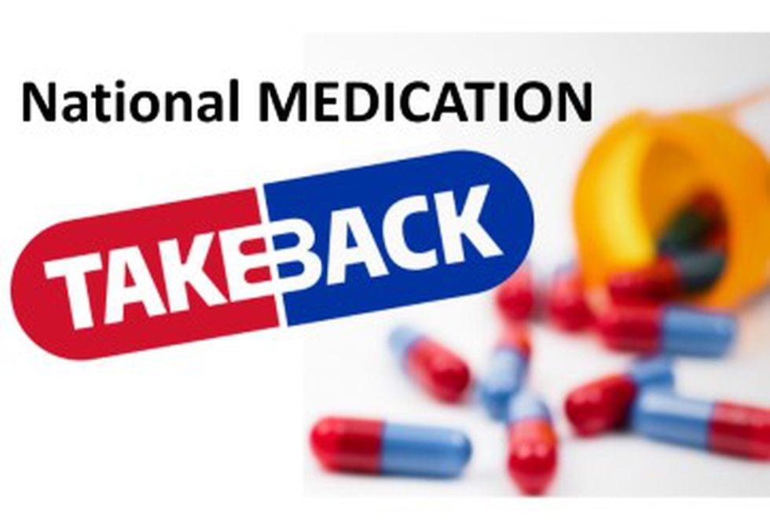
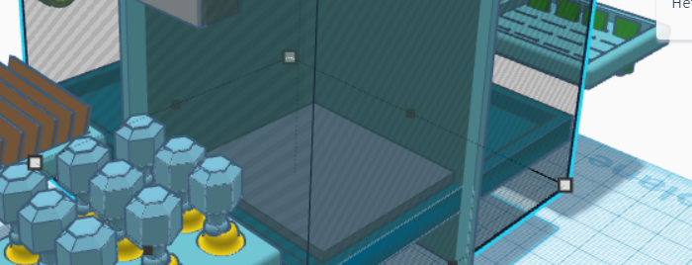
PharmaSee: How the Device Functions
Drug Identification System
How PharmaSee* Works and its Features
Drugs are identified and stored in the system in 3 steps:
Medicine container is placed in front of camera
Optical Character Recognition (OCR) system identifies what the drug is and searches what category it falls into from a lookup table
The relevant compartment is opened and the LED light corresponding to the assigned slot is highlighted.
Identification
Expiry and opening dates for the drug are also entered by the user, thus completing the drug identification process
Methods of Disposal
Storage
Storage of data such as expiry date
Take Back Program
Sand- Mixing
The device is connected to municipal organizations or pharmacies in the vicinity, and updates are sent to these organizations when there are enough medicines to be collected
Medicines are mixed with sand or litter present in the sandbox, neutralizing them in the process, thereby preventing environmental contamination. The user disposes of them from time to time
Disposal

Slide 3
PharmaSee: The Impact
Instances wherein Take-Back Programs Helped Significantly Reduce Improper Disposal of Pharmaceutical Drugs Globally
Potential Impact of Our Product
National Prescription Drug Take-Back Day (USA) collects hundreds of thousands of pounds worth of unused medicines at each event.
Return Unwanted Medicines Project (Australia) collects approximately 700 tons of unused medicines every year through its programs.
Aim and Purpose
Lessen lack of awareness for storage and disposal methods
Create proper channels and aid take back programs as well as ensure proper home disposal through sand-mixing
Increase responsibilities of companies to properly use and disposal of pharmaceutical products
Take-back programs help in the following ways:
They reduce the accidental usage of expired or unwanted medicines
They prevent the leaching of medicines into the soil and water bodies, thereby ensuring a less polluted environment
They support community health initiatives and responsible medication use
Creation of awareness and channels for disposal which lessens negative impact on water bodies
THANK YOU

